Slide 1
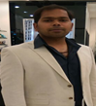


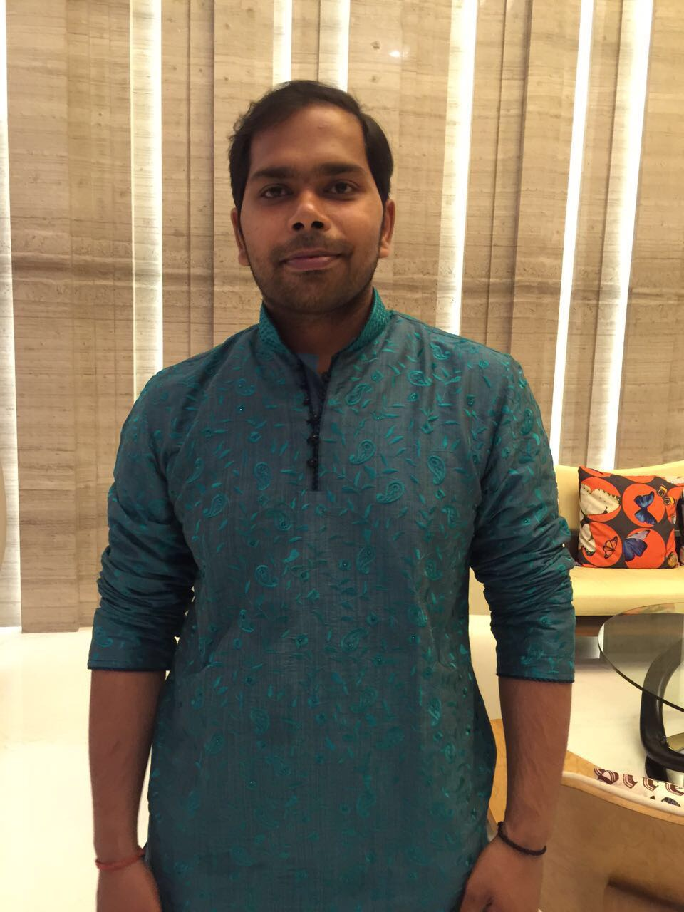
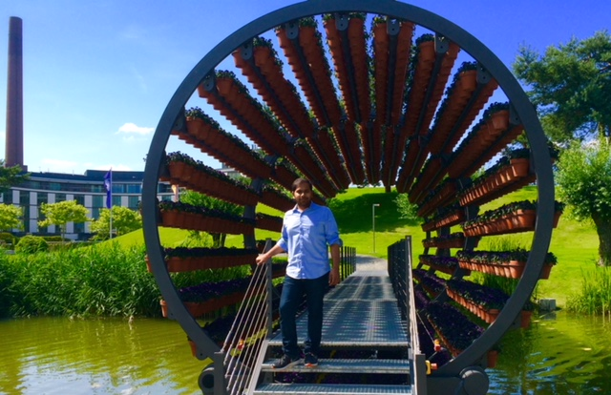

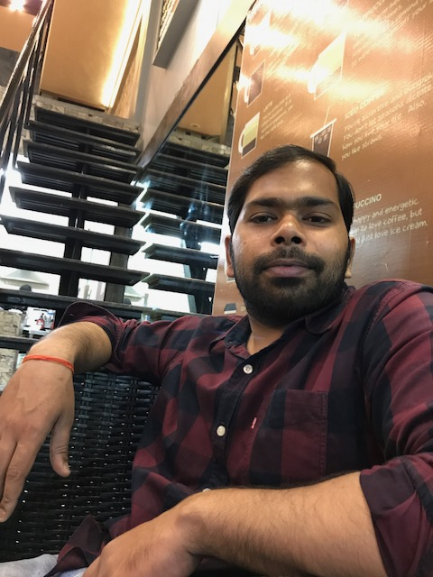
Yogarshi Shukla DevOps & Security Engineer
A competent professional with experience in DevOps,
Automation, Build and Configuration Management for
Application Development.
DevOps & Security Engineer
McDermott Intl.
(Current)
Experience
Application Development Senior Analyst Accenture – Pune (Expertise: Cloud Computation on AWS/Azure Dockerization, Infrastructure Management of Microservices Configuration Management)
2015: Application Development Analyst Accenture – Pune (Expertise: Achieving Continuous Delivery through Job/Pipelining, DB, Scripting, Automation Network Security)
2013: Software Developer MRC – Bangalore (Expertise: Operational Skill of Jenkins, Branching Concepts of SCM, OS Knowledge)
About Me:
Birthplace: Allahabad, UP, India
Education: B.Tech with Computer Science
Hobbies : Travelling, watching Cricket Singing
Senior Software Engineer
Accenture Svc Pvt Ltd
(2.5 Years)
Software Engineer
Accenture Svc Pvt Ltd
(2 Years)
Software Developer
Municipal Reforms Cell
(2 Years)

